Slide 1

Spotify Chart Trend Analysis
Presented By:
Bansode Pornima Phansekar Ojas Jain Shreya Shah Dharit
Girme Harshal

Slide 2
Introduction

Slide 3
Music Industry Evolution
Recent research work
Why spotify
Problem statement
Purpose and goal

Slide 4
Background

Slide 5
Machine learning algorithms
Logistic Regression
Random Forest
Decision Tree Classifier
K-Nearest Neighbours
Linear SVC
Arima Model

Slide 6
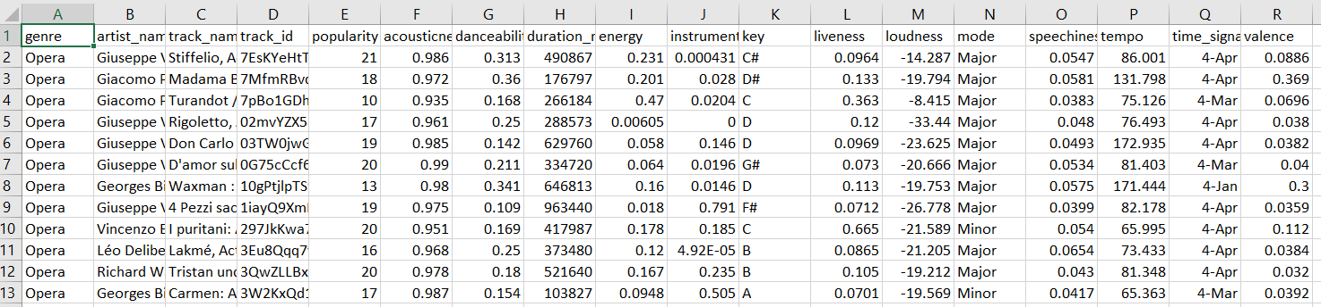
DATA

Slide 7
Logistic Regression

Slide 8
Logistic Regression
Logistic regression is the appropriate regression analysis to conduct when the dependent variable is dichotomous (binary).
Like all regression analysis, logistic regression is a predictive analysis.
Logistic regression is used to describe data and to explain the relationship between one dependent binary variable and one or more nominal, ordinal, interval or ratio-level independent variables.

Slide 9
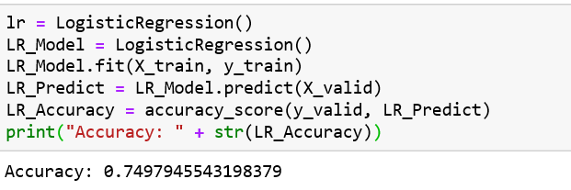

Slide 10
K-Nearest Neighbours

Slide 11
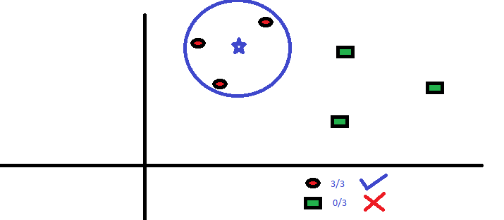
K-Nearest Neighbours
We define 80% of the dataframe for training and 20% of the dataframe for testing and added a validation dataset using train_test_split.
A positive integer k is specified, along with a new sample
We select the k entries in our database which are closest to the new sample
We find the most common classification of these entries
This is the classification we give to the new sample

Slide 12
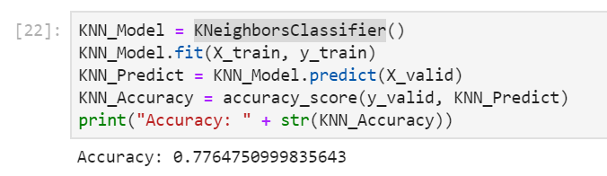

Slide 13
Decision Tree Classifier

Slide 14
Decision Tree Classifier
In this technique, we split the population or sample into two or more homogeneous sets based on most significant splitter in input variables.
Decision tree builds classification or regression models in the form of a tree structure. It breaks down a dataset into smaller and smaller subsets
Decision trees classify instances by sorting them down the tree from the root to some leaf node, which provides the classification of the instance. An instance is classified by starting at the root node of the tree,testing the attribute specified by this node,then moving down the tree branch corresponding to the value of the attribute as shown in the above figure.This process is then repeated for the subtree rooted at the new node.

Slide 15
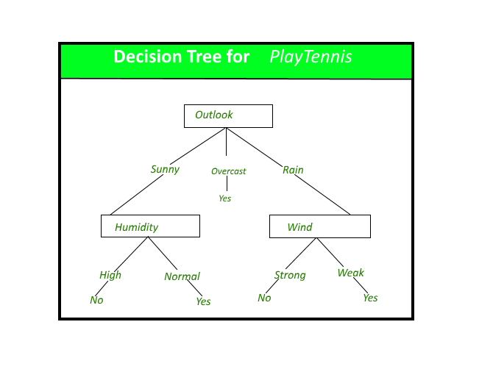
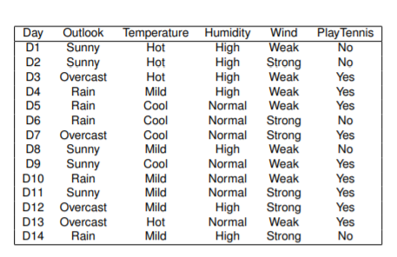
Linear SVC

Slide 16
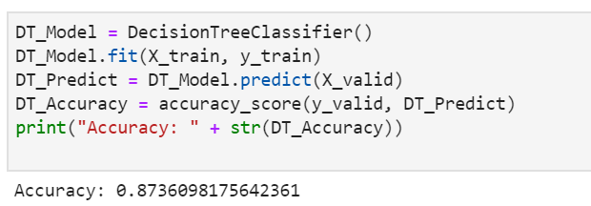

Slide 17
Linear SVC

Slide 18
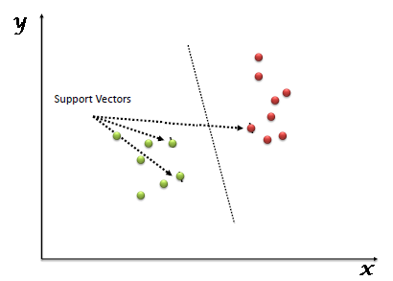
Linear SVC
In this algorithm, we plot each data item as a point in n-dimensional space (where n is number of features you have) with the value of each feature being the value of a particular coordinate. Then, we perform classification by finding the hyper-plane that differentiate the two classes very well
Support Vectors are simply the
co-ordinates of individual observation.
Support Vector Machine is a frontier
which best segregates the two classes
(hyper-plane/ line)

Slide 19
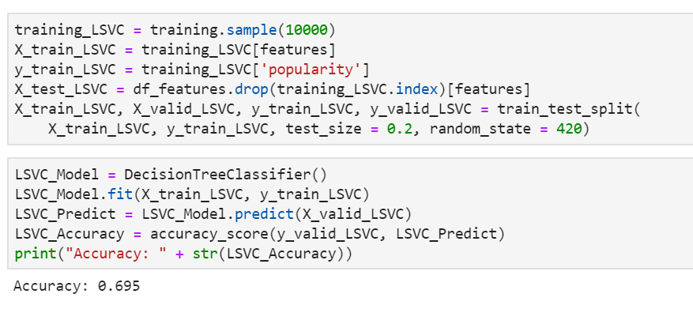

Slide 20
Random Forest

Slide 21

Random Forest
Random forest classifier creates a set of decision trees from randomly selected subset of training set. It then aggregates the votes from different decision trees to decide the final class of test object.

Slide 22
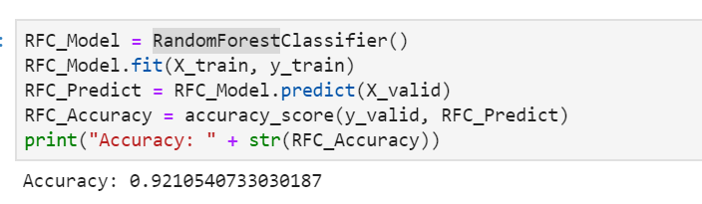

Slide 23
What is ARIMA ?

Slide 24
ARIMA(Auto Regressive Integrated Moving Average)
ARIMA models provide approach to time series forecasting(We are using it for next day streaming forecasting)
Exponential smoothing and ARIMA models are the two most widely used approaches to time series forecasting, and provide complementary approaches to the problem.
Non -Seasonal and Seasonal ARIMA models
While exponential smoothing models are based on a description of the trend and seasonality in the data, ARIMA models aim to describe the autocorrelations in the data.

Slide 25
ARIMA(Autoregressive Integrated Moving Average)
AR Autoregression. A model that uses the dependent
relationship between an observation and some number of
lagged observations.
I Integrated. The use of differencing of raw observations in
order to make the time series stationary.
MA Moving Average. A model that uses the dependency
between an observation and a residual error from a moving
average model applied to lagged observations.
Each of these components are explicitly specified in the model
as a parameter.
AR and MA are two widely used linear models that
work on stationary time series, and I is a preprocessing
procedure to “stationarize” time series if needed.

Slide 26
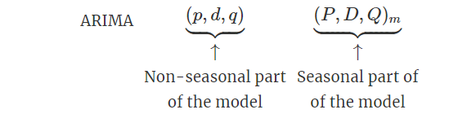
Seasonal Arima Model
p The number of lag observations included in the model, also
called the lag order.
d The number of times that the raw observations are
differenced, also called the degree of differencing.
q The size of the moving average window, also called the order
of moving average.
m = number of observations per year

Slide 27
Seasonal Arima Model
A seasonal ARIMA model uses differencing at a lag equal to the number of seasons (s) to remove additive seasonal effects. As with lag 1 differencing to remove a trend, the lag s differencing introduces a moving average term. The seasonal ARIMA model includes autoregressive and moving average terms at lag s.
Seasonal ARIMA models can potentially have a large number of parameters and combinations of terms. Therefore, it is appropriate to try out a wide range of models when fitting to data and choose a best fitting model using an appropriate criterion

Slide 28
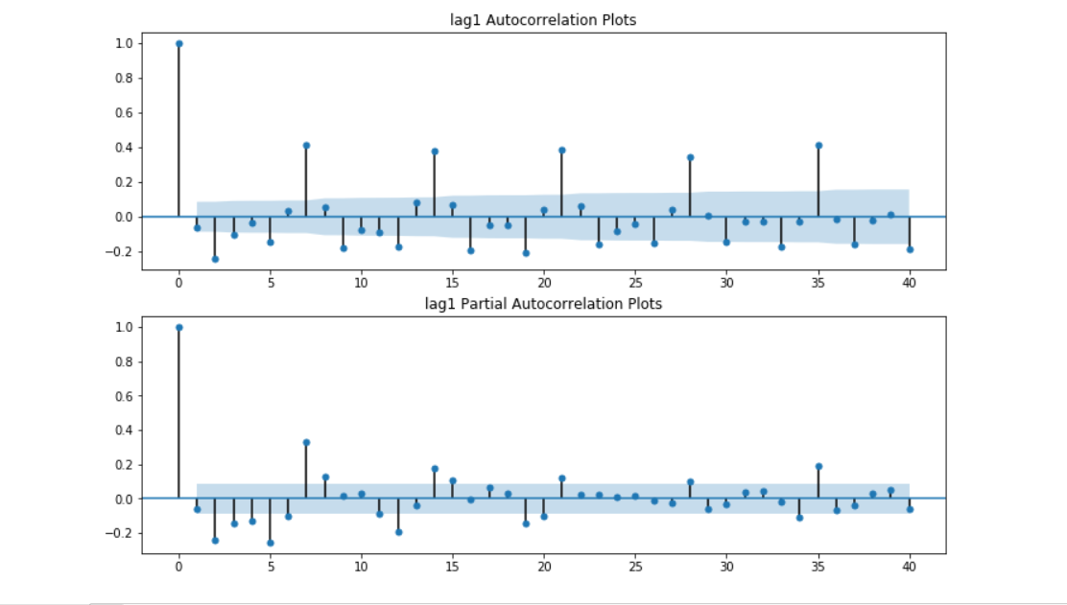
Autocorrelation and Partial Autocorrelation
Autocorrelation refers to how correlated a time series is with its past values whereas the ACF is the plot used to see the correlation between the points, up to and including the lag unit. In ACF, the correlation coefficient is in the x-axis whereas the number of lags is shown in the y-axis.
Partial autocorrelation plots (PACF), as the name suggests, display correlation between a variable and its lags that is not explained by previous lags. PACF plots are useful when determining the order of the AR model.

Slide 29
Approach

Slide 30
Extract Data/Specifications
Preprocess Data
Model Building
Prediction
Results

Slide 31
Extract Data
The datasets we used in this research contains the day by day positioning of the 200 most listened tunes in 53 nations from 2017 by Spotify clients.
It includes 6629 artists, 18598 songs for an all-out check of 105 billion streams tally.
The information ranges from 1st January 2017 to 31st December 2017 and will stay up with the latest on following adaptations. It has been gathered from Spotify's provincial graph information.

Slide 32
Preprocess Data
The preprocessing part of the workflow is cleaning the data, we removed null values. To avoid this issue, we decided not to use complete datasets, but instead use 2 different datasets for features. We had to make sure, we are not including any duplicate data that could affect the model.
We plotted number of streams and country to the months of 2017, to check the distribution of users.

Slide 33
Model Building
We used different machine learning algorithms and ARIMA to get the optimal model. Initially we started with ARIMA, to predict the time series forecasting. The algorithms we used are Decision Trees, Random Forest, Logistic Regression, K-Nearest neighbors classifier, Linear Support Vector Classification and XGBoost.
The models were implemented to check the popularity of the songs based on the features, with top 25% of songs being popular and bottom 75% as not popular.
ARIMA model was implemented to predict the streams of the songs, i.e the stream for the next day.

Slide 34
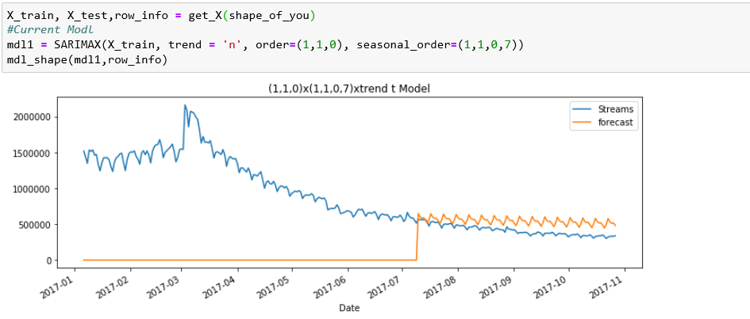
Prediction
To validate the models we tried changing the parameters in the ARIMA model to reflect the trend. The first experiment showed a bad model where we added parameters as order(1,1,0) and seasonal(1,1,0,7).

Slide 35
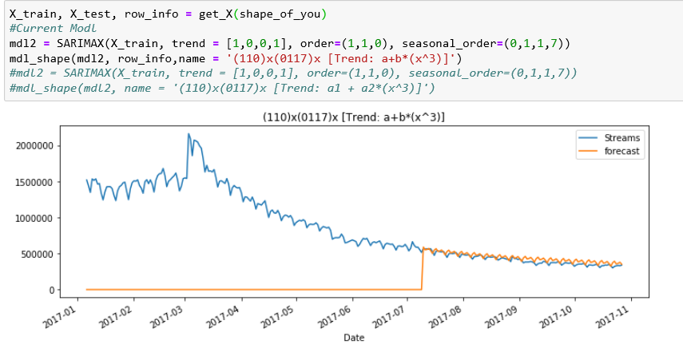
Prediction
Further, tweaking the parameters we made few changes: order(1,1,0) and seasonal(0,1,1,7). This improved the model pretty decent.

Slide 36
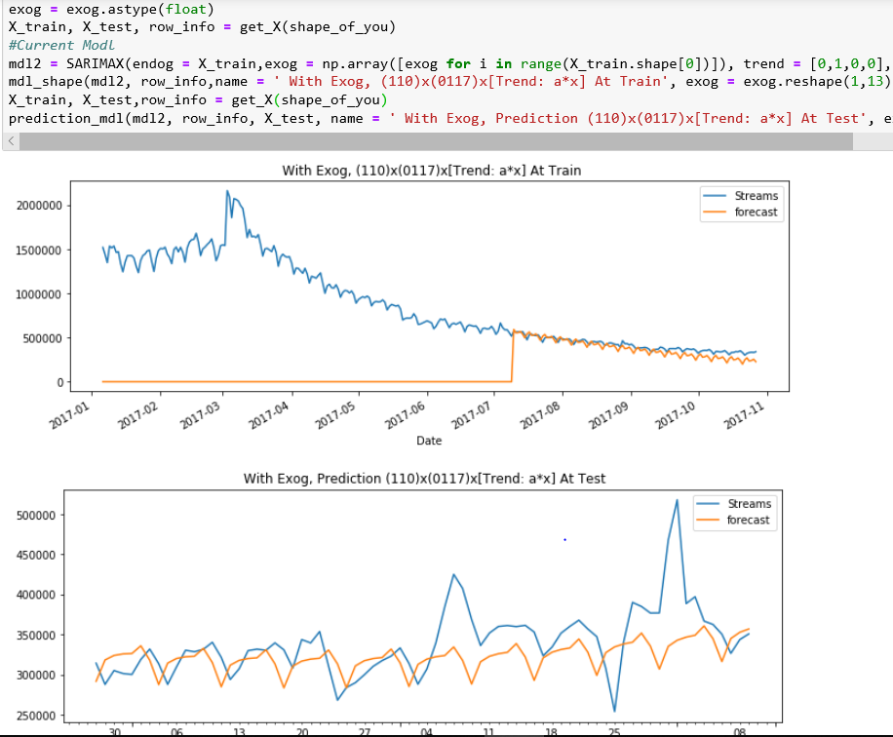
Prediction
To improvise the model we tested Exogenous SARIMAX with x variables. Here, we first tried tweaking the parameters again using order(1,1,0) and seasonal(0,1,1,7) we got

Slide 37
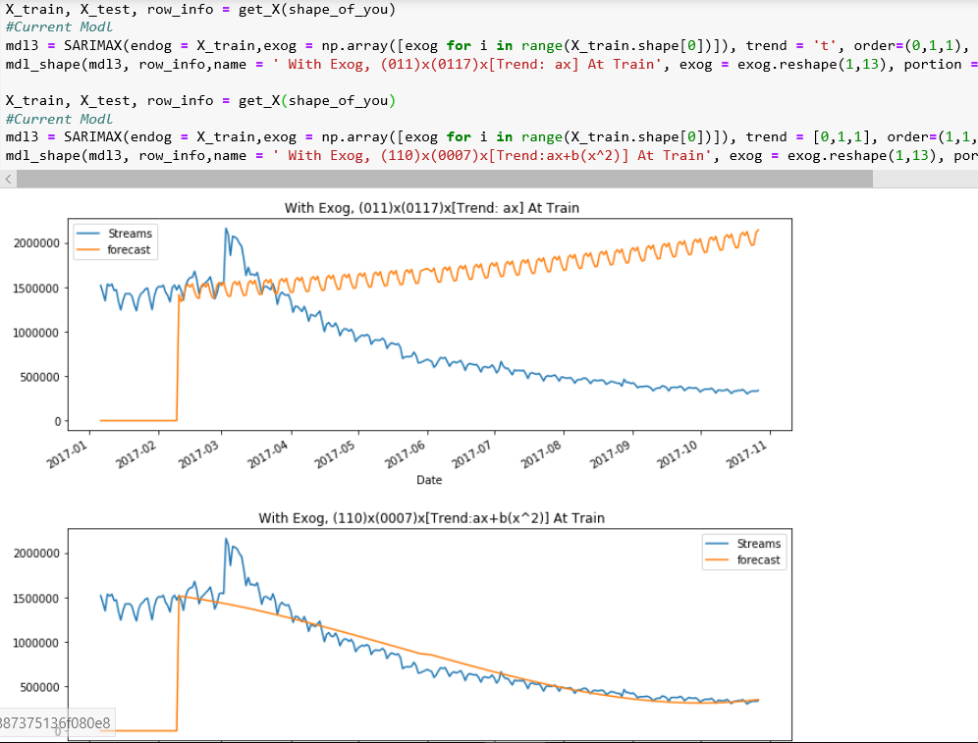
The attached x variable helped a lot in improving the model. Additionally, we tried to make changes in the parameter to test if we could reach to the optimal model, we used order(0,1,1) and seasonal(0,0,0,7). This gave the below result:

Slide 38
ARIMA Conclusion:
The exogenous SARIMAX proved to be a good model.
In the previous prediction the power peak up, but ARIMA completely ignored the peak up and gave a good forecasting for the streams.

Slide 39
Exploratory Data Analysis

Slide 40
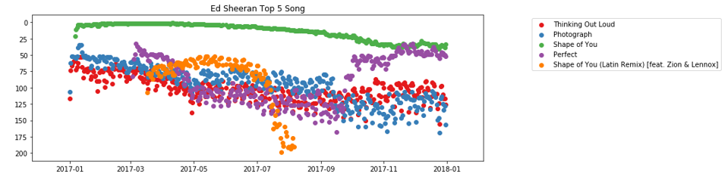
Exploratory Data Analysis
TOP 5 SONGS OF ED SHEERAN

Slide 41
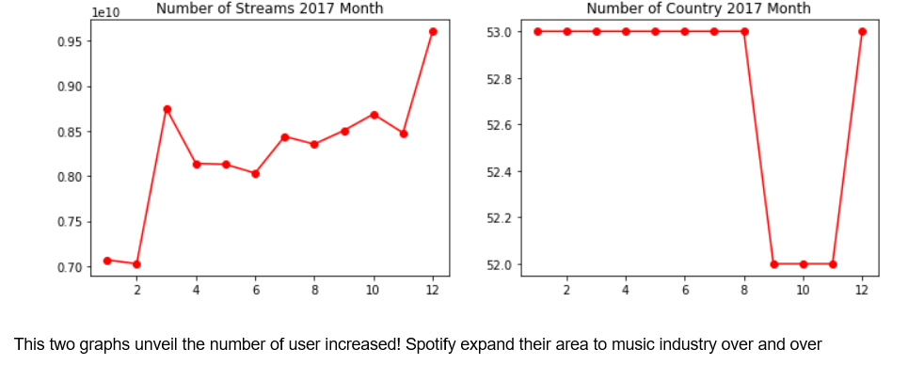
Exploratory Data Analysis
NUMBER OF USERS INCREASED

Slide 42
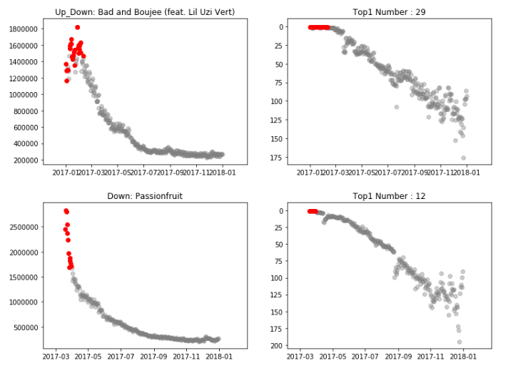
Exploratory Data Analysis
THE GRAPHS SHOW 7 DIFFERENT TYPES OF TOP 1

Slide 43
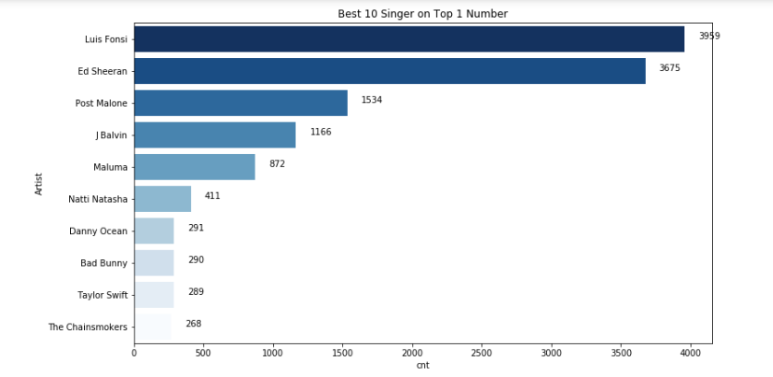
Exploratory Data Analysis
TO DETERMINE TOP 10 SINGERS ACCORDING TO TOP 1 SONG

Slide 44
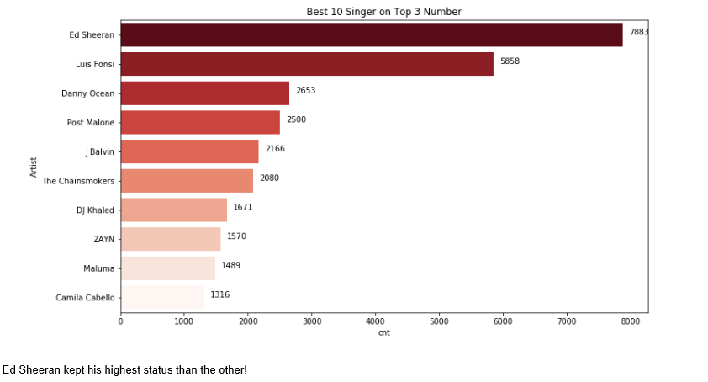
Exploratory Data Analysis
TO DETERMINE TOP 10 SINGERS ACCORDING TO TOP 3 SONGS

Slide 45
Results

Slide 46
Results
ARIMA models provide approach to time series forecasting
Two most widely used approaches to time series forecasting :
1. Exponential Smoothing
2. ARIMA models
They also provide complementary approaches to the problem.
Exponential smoothing models are based on a description of the trend and seasonality in the data
ARIMA models aim to describe the autocorrelations in the data.

Slide 47
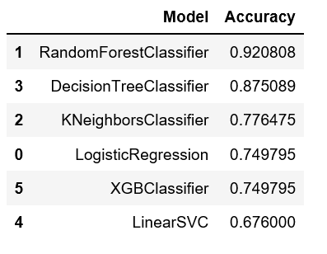
Results
Best Performer
Worst Performer

Slide 48
Future Scope

Slide 49
We plan to implement LSTM and to check if it gives better results than the algorithms we used while carrying out this project. LSTM model can also be improvised to get better results by modifying the batch size,window size, hidden layer, clip margin and epochs. Also, LSTM can further iterate through every window in batch and for every point in window we can feed LSTM to get the next output. End result will be considered as the prediction.

Slide 50
Conclusion

Slide 51
Using this dataset of Spotify Tracks, we were able to predict popularity using audio-based metrics such as key, mode, and danceability without external metrics such as artist name, genre, and release date. The Random Forest Classifier was the best performing algorithm with 92.0% accuracy. The Decision Tree Classifier was the second best performing algorithm with 87.5% accuracy. Linear Support Vector Classification performed worst with least accuracy rate of 69.5%.

Slide 52

THANK YOU

